Slide 1
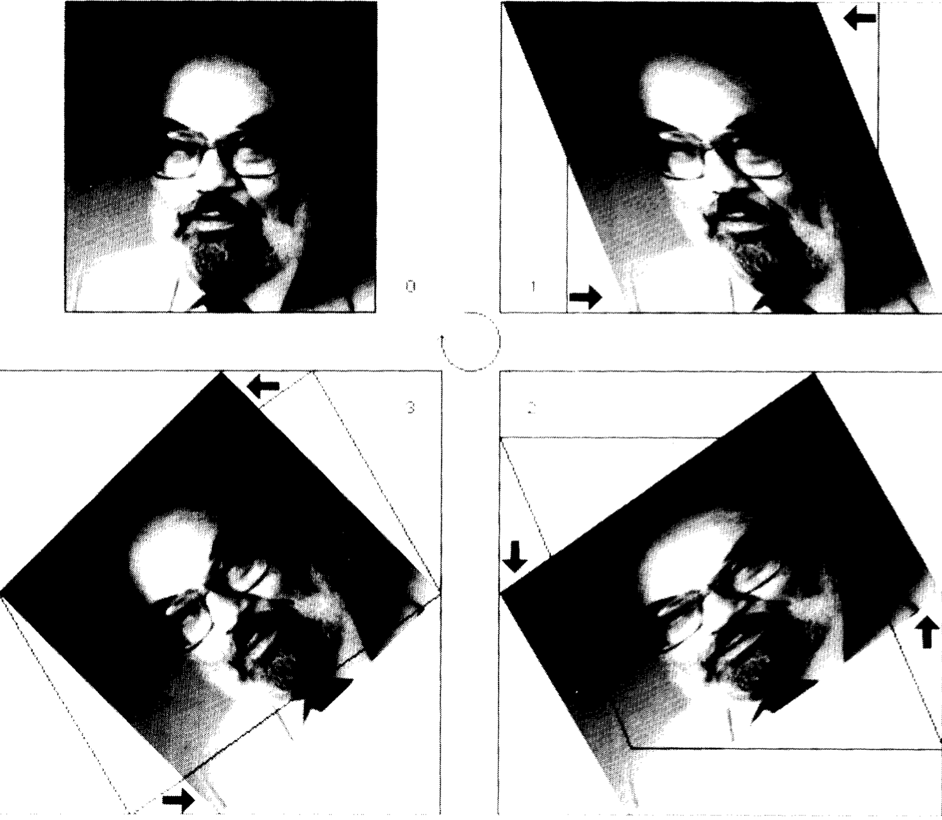
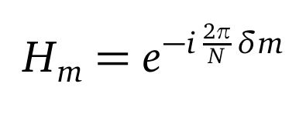
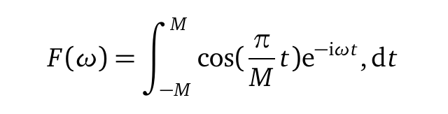
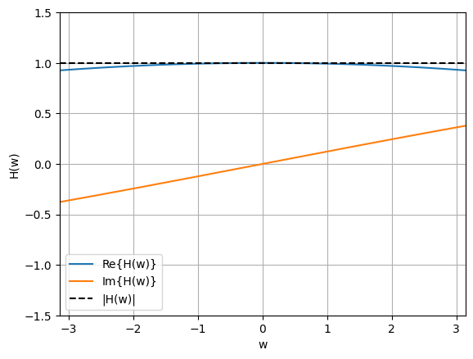
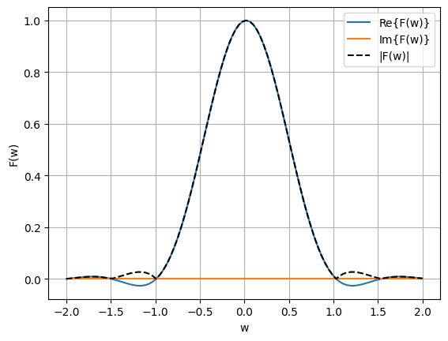
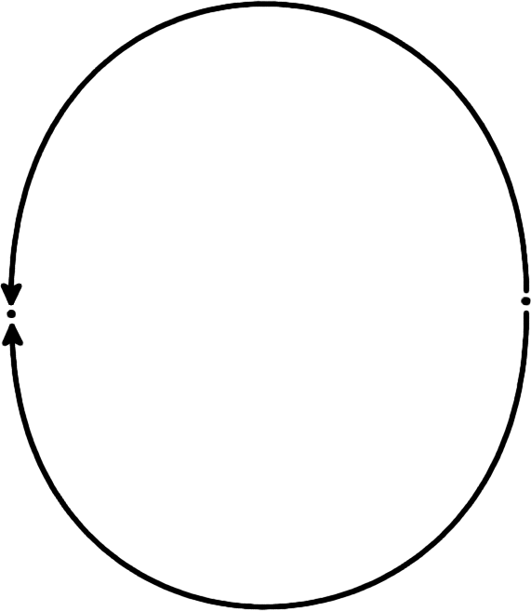
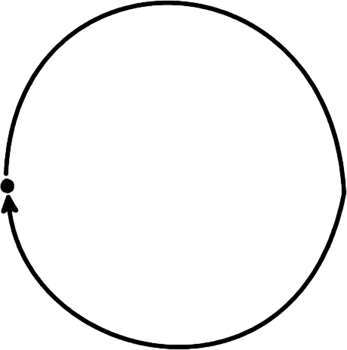
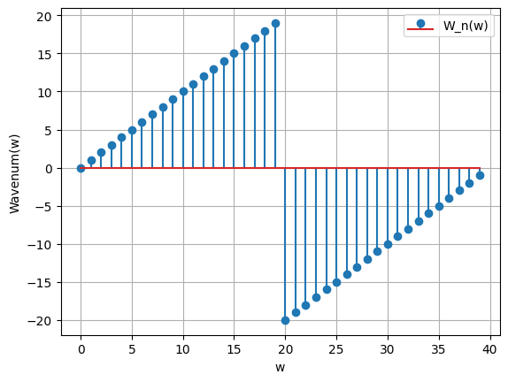
Rotation of multidimensional signals with spectral schemes
Student: Dylan Reid Ramelli
Advisor: Prof Rolf Krause
Co-Advisors: Dr Diego Rossinelli,
Dr Patrick Zulian
Large-scale in-silico investigation on the homeostasis within the subarachnoid space of the optic nerve, Rossinelli et al. 2023, in-preparation.
Homeostasis is directly related on interaction between the cerebrospinal fluid flow and the meningeal surface.
Blue denotes poor levels of homeostasis , whereas red denotes sufficient levels.
Motivation
Performance and Quality
The goal of the project is the implementation of a numerical method to rotate a multidimensional signal while maintaining both a high degree of accuracy and performance.
Rotations expressed as sequence of 3 2D rotations.
Data alignment for ray traversal and light attenuation calculations.
Three 1D translations of data
...
Three-pass rotation, Michael Unser
Frequency analysis
Digital Filter Design / FIR
Frequency indexing

